Slide 1
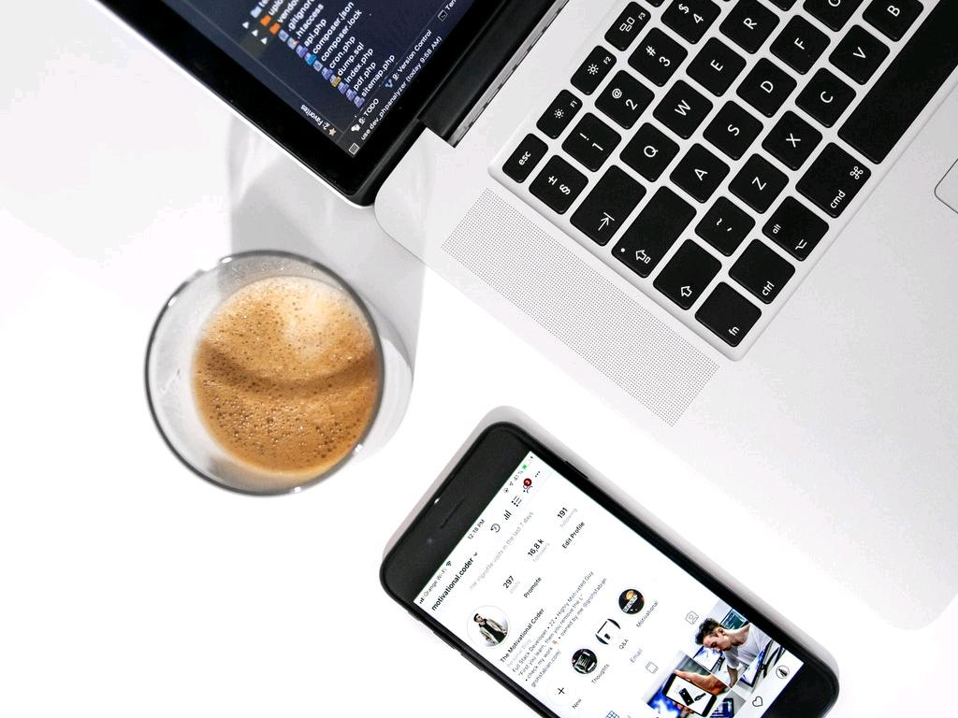

Task’d
Stream-line the group project experience:
Created with Haiku Deck
Notes:
I had my first group project in 7th grade. There were four of us, and my job was to write the scripts. Leading up to the day before the presentation, I hadn't heard from any of them. I knew if I didn't step in, we would all fail. That night I finished a makeshift poster of staples and printer paper. I remember imagining how proud my teammates would be that I saved the presentation. The day of, none of them showed up and I presented alone. You would think that as I enrolled in college, group projects would get better. Unfortunately, they haven't.

Slide 2




Problem
Group projects cause students more work, time, and responsibility
Group projects fail due to lack of:
Communication
Accountability
Organization
Notes:
Group projects cause students more work, Especially when members don't communicate with the entire team, do their part, or follow the plan.

Slide 3
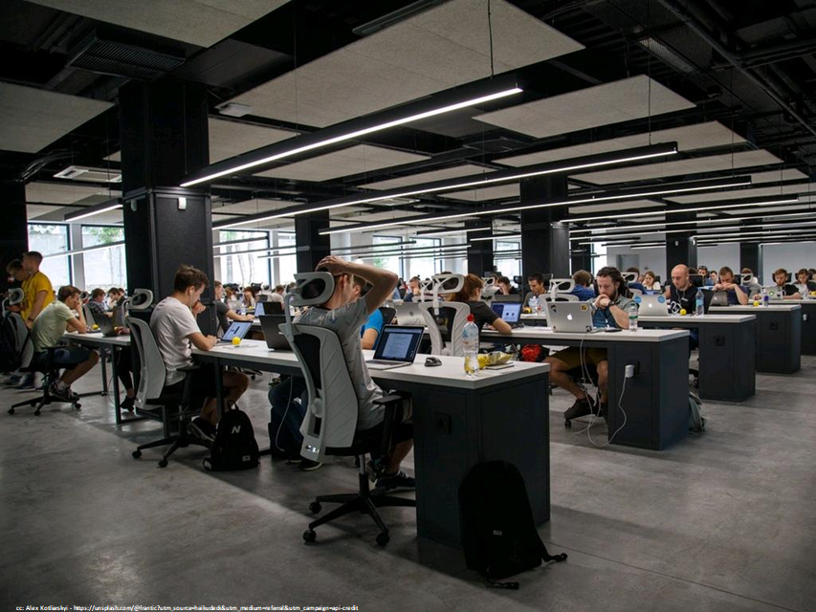


Solution
A Project Management app that promotes:
Communication between team members
Efficient prioritization
Achieving Milestones
Notes:
Our solution is an app with time-saving communication, intuitive project guidance, and a teamwork focused collaboration

Slide 4
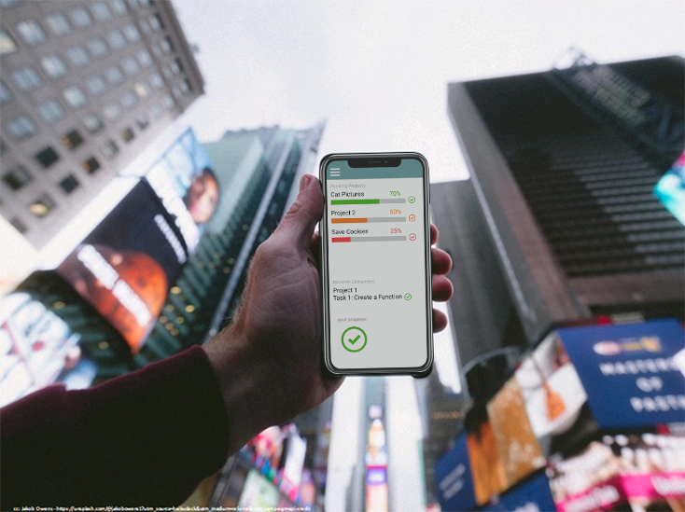
Stream-line the group project experience:
Task’d
Notes:
Welcome to the future of group projects.

Slide 5

Task'd
Instantly gauge progress on a single screen, anytime, anywhere
Seamlessly communicate and stay connected with your team
Guides teams to achieve their goals
Tracks everyone's progress
Notes:
Task'd provides maximum visibility into your entire project, giving you peace of mind.
You'll be able to stay connected with your team and progress anytime, anywhere.
Long gone are the frustrating days of miscommunication, lack of participation, and failure.
It is the only way to guarantee your project goes as smoothly as possible.

Slide 6

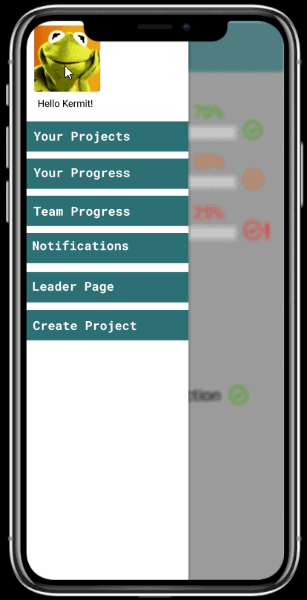
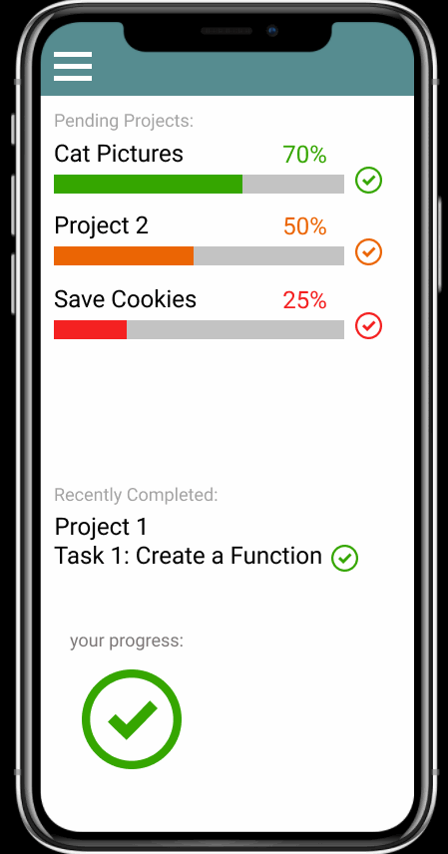
Notes:
Here is a successful project where user Cookie Monster needs help. We can see signs that Cookie isn't able to finish this task, and needs help. Clicking this feature notifies the team where to help out.
Here's a project that is in the red and failing. As we click through we can see who is completing their portion, and who is falling behind. We can see that Kermit is doing okay, and

Slide 7
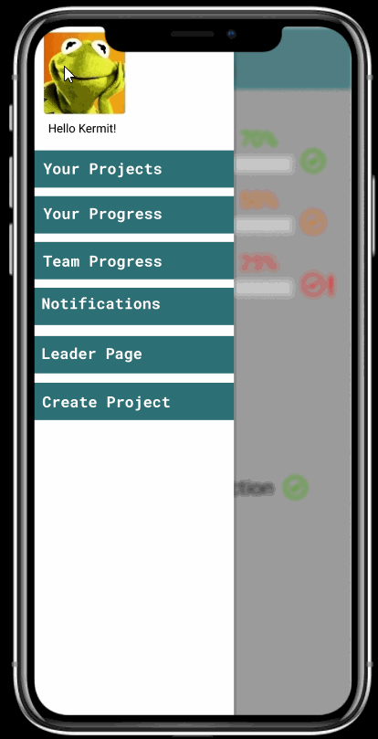
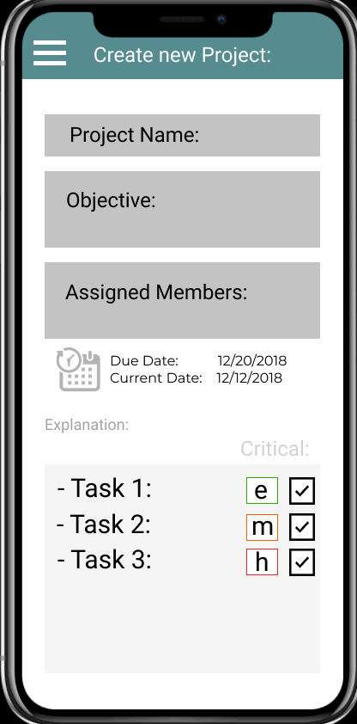
Notes:
Our objective is to provide the most condensed, user friendly start process

Slide 8
Competitive Advantages
Ease of use success in a single, simple screen
Anytime, Anywhere never fall behind
Student Oriented first project manager for students
Notes:
Task'd is the most simple yet powerful project manager for students

Slide 9

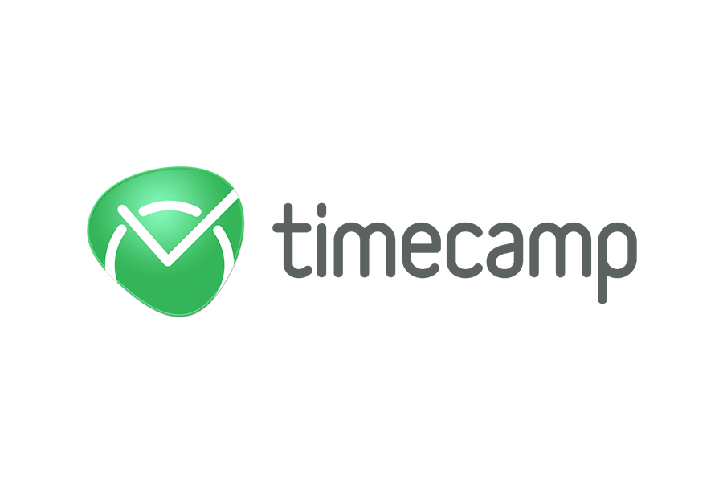

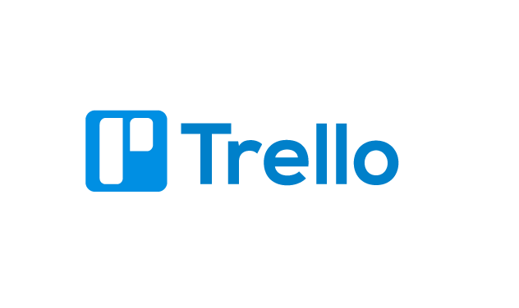
Expensive
Lower learning curve
Task'd
Affordable
Higher learning curve
Notes:
Task'd currently only has one competitor, timecamp

Slide 10
Market
Students using Chromebooks & iPads
Project management apps for students
300 million
2
Most of these students will have multiple group projects
Notes:
Group projects are inevitable in schools and our mission is to capture the student market

Slide 11
Roadmap
Future features
Inbox where tasks can be submitted and reviewed.
Check milestones within a task.
More robust chat feature
Set up meeting events
Future direction
Try to partner with tech companies and expand the app for a professional setting
Desktop application
Notes:
If you were to work on this longer-term, what is the father future potential of your app?
What cool new features could be added in the future?

Slide 12
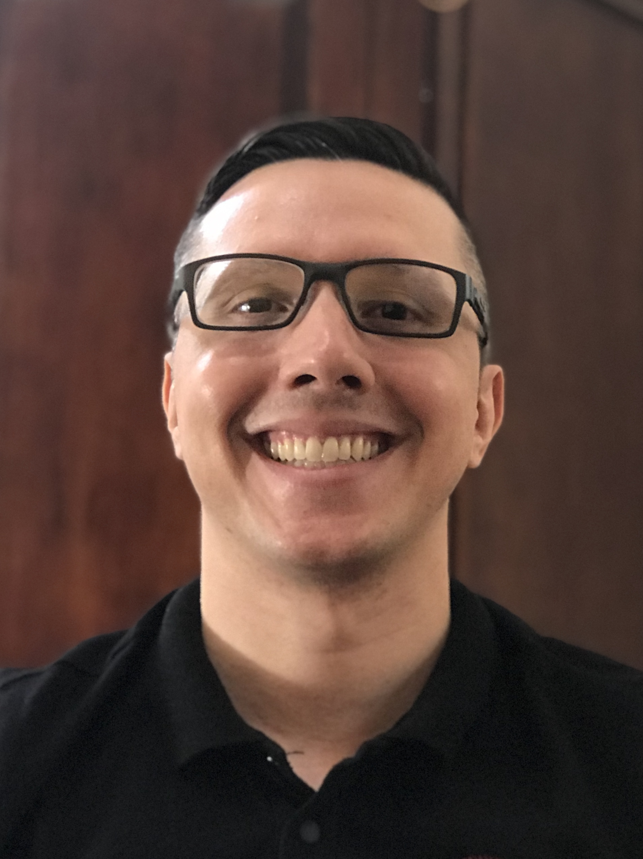
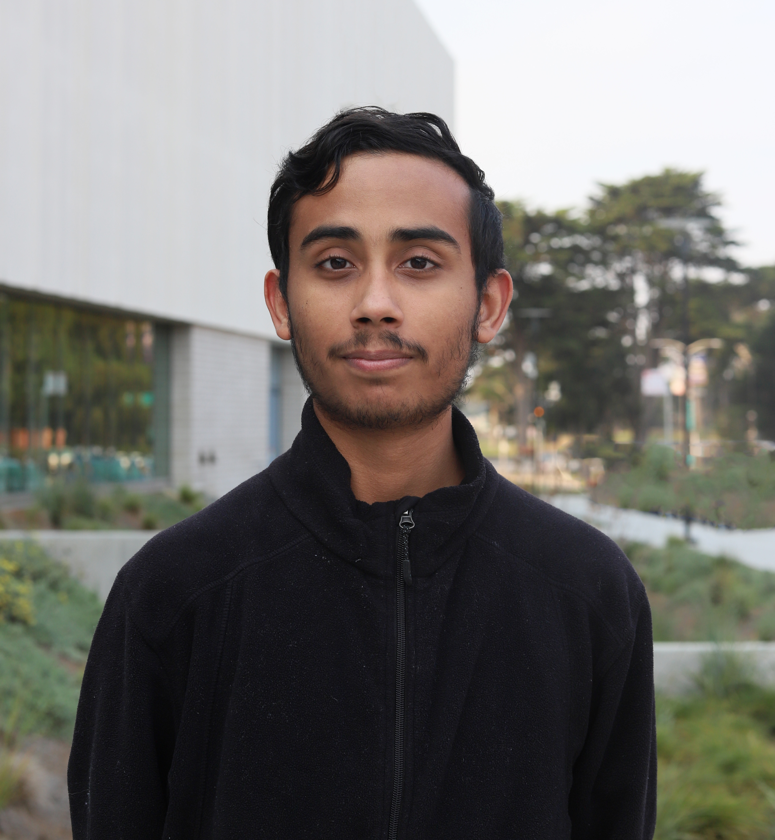
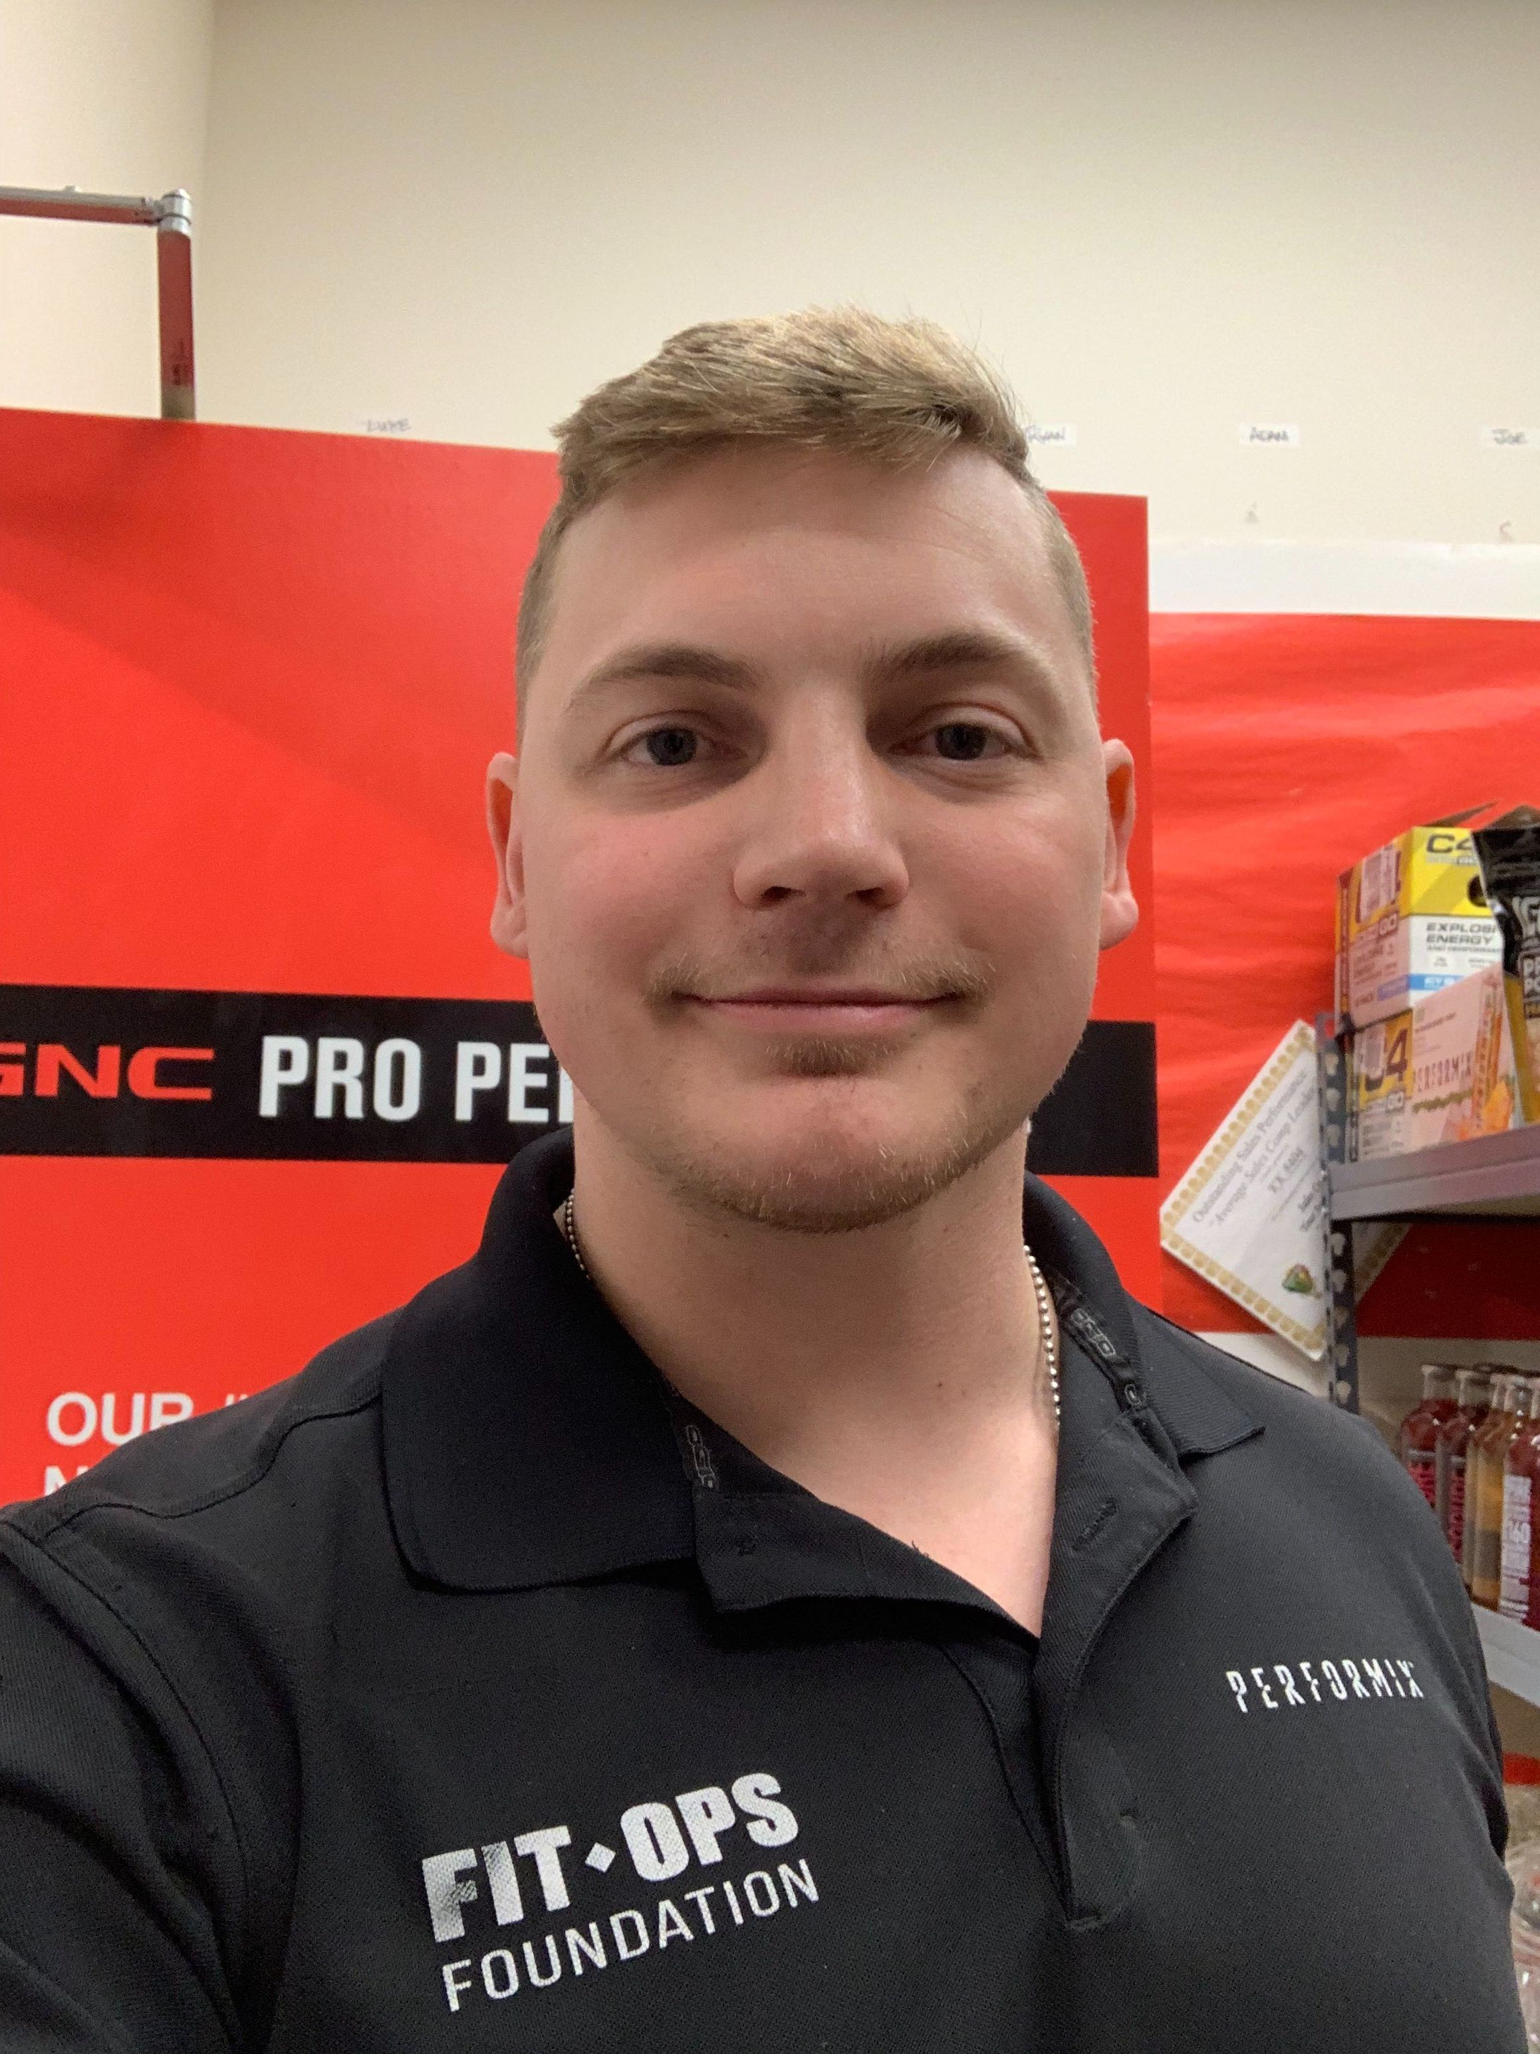
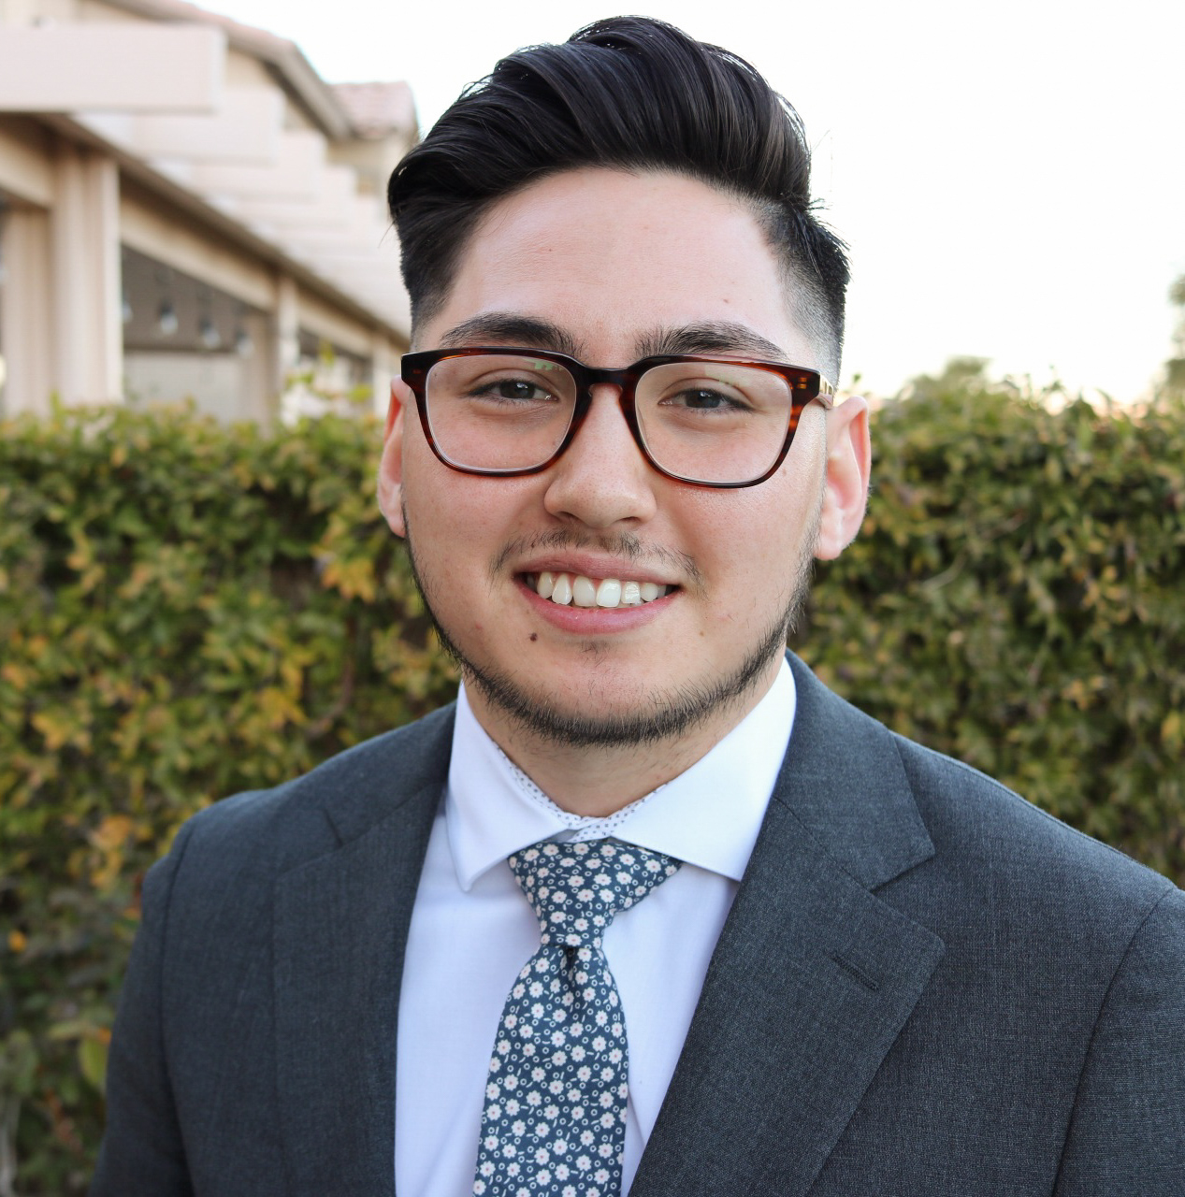
Credits: TaCode Tuesday
Bryan Caldera
José L Dávila
Montalvo
Anthony Ronca
Michael Benton
Notes:
This slide introduces your team
You can include photos and “roles” or not, up to you!

